Slide 1
Knowledge Base System, Reasoning and Representation

Slide 2


To solve complex problems we need:
Large amount of knowledge
Mechanism for representation and manipulation of existing knowledge to create new solution.
Two Types of Knowledge:
(i) Procedural (ii) Declarative
Knowledge Representation
Facts: Things we want to represent. Truth in some relevant world.
Representation of facts.

Slide 3
Representation and Mapping
Spot is a dog
dog(Spot)
Every dog has a tail
∀x: dog(x) → hastail(x)
hastail(Spot)
Spot has a tail
3

Slide 4
Representation and Mapping
No. black squares
= 30
No. white square
= 32
8

Slide 5
Approaches to KR
1. Simple relational knowledge:
Provides very weak inferential capabilities.
May serve as the input to powerful inference engines.
Player | Height | Weight | handed
Peter | 6-0 | 180 | right
Ajay | 5-10 | 170 | left
John | 6-2 | 215 | left
Vickey | 6-3 | 205 | right
Fails to infer “which right handed player can best face a particular bowler” .
10

Slide 6
Approaches to KR
Inheritable knowledge:
Objects are organized into classes and classes are organized in a generalization hierarchy.
Inheritance is a powerful form of inference, but not adequate.
Ex. Property inheritance inference mechanism.
isa
handed
Adult male
Person
Right
instance
Peter
Consultancy
11
Works_at

Slide 7
Approaches to KR
Inferential knowledge:
Facts represented in a logical form, which facilitates reasoning.
An inference engine is required.
ex. 1. “Marcus is a man”
2. “All men are mortal”
Implies:
3. “Marcus is mortal”
12

Slide 8
Approaches to KR
Procedural knowledge:
Representation of “how to make it” rather than “what it is”.
May have inferential efficiency, but no inferential
adequacy and acquisitional efficiency.
Ex. Writing Prolog programs

Slide 9
Some General Representations
Logical Representations
Production Rules
Semantic Networks
Conceptual graphs, frames
Description Logics (see textbook)

Slide 10
Big Ideas
Logic is a great knowledge representation language for many AI problems
Propositional logic is the simple foundation and fine for some AI problems
First order logic (FOL) is much more expressive as a KR language and more commonly used in AI

Slide 11
Propositional logic
Logical constants: true, false
Propositional symbols: P, Q,... (atomic sentences)
Wrapping parentheses: ( … )
Sentences are combined by connectives:
∧ and [conjunction]
∨ or [disjunction]
⇒ implies [implication / conditional]
⇔ is equivalent [biconditional]
¬ not [negation]
Literal: atomic sentence or negated atomic sentence
P, ¬ P

Slide 12
Examples of PL sentences
(P ∧ Q) → R
“If it is hot and humid, then it is raining”
Q → P
“If it is humid, then it is hot”
Q
“It is humid.”
We’re free to choose better symbols, btw:
Ho = “It is hot”
Hu = “It is humid”
R = “It is raining”

Slide 13
Propositional logic (PL)
Simple language for showing key ideas and definitions
User defines set of propositional symbols, like P and Q
User defines semantics of each propositional symbol:
P means “It is hot”, Q means “It is humid”, etc.
A sentence (well formed formula) is defined as follows:
A symbol is a sentence
If S is a sentence, then ¬S is a sentence
If S is a sentence, then (S) is a sentence
If S and T are sentences, then (S ∨ T), (S ∧ T), (S → T), and (S ↔ T) are sentences
A sentence results from a finite number of applications of the rules

Slide 14
Some terms
The meaning or semantics of a sentence determines its interpretation
Given the truth values of all symbols in a sentence, it can be “evaluated” to determine its truth value (True or False)
A model for a KB is a possible world – an assignment of truth values to propositional symbols that makes each sentence in the KB True

Slide 15


Truth tables
Truth tables are used to define logical connectives
and to determine when a complex sentence is true given the values of the symbols in it
Truth tables for the five logical connectives
Example of a truth table used for a complex sentence

Slide 16
Inference rules
Logical inference creates new sentences that logically follow from a set of sentences (KB)
An inference rule is sound if every sentence X it produces when operating on a KB logically follows from the KB
i.e., inference rule creates no contradictions
An inference rule is complete if it can produce every expression that logically follows from (is entailed by) the KB.
Note analogy to complete search algorithms

Slide 17
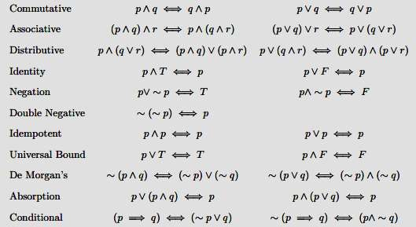
Inference rules:

Slide 18
Soundness of modus ponens
A | B | A → B | OK?
True | True | True | √
True | False | False | √
False | True | True | √
False | False | True | √

Slide 19
Resolution
Resolution is a valid inference rule producing a new clause implied by two clauses containing complementary literals
A literal is an atomic symbol or its negation, i.e., P, ~P
Amazingly, this is the only interference rule you need to build a sound and complete theorem prover
Based on proof by contradiction and usually called resolution refutation
The resolution rule was discovered by Alan Robinson (CS, U. of Syracuse) in the mid 60s

Slide 20
Resolution
A KB is actually a set of sentences all of which are true, i.e., a conjunction of sentences.
To use resolution, put KB into conjunctive normal form (CNF), where each sentence written as a disjunc- tion of (one or more) literals
Example
KB: [P→Q , Q→R∧S]
KB in CNF: [~P∨Q , ~Q∨R , ~Q∨S]
Resolve KB(1) and KB(2) producing: ~P∨R (i.e., P→R)
Resolve KB(1) and KB(3) producing: ~P∨S (i.e., P→S)
New KB: [~P∨Q , ~Q∨~R∨~S , ~P∨R , ~P∨S]
Tautologies
(A→B)↔(~A∨B)
(A∨(B∧C)) ↔(A∨B)∧(A∨C)

Slide 21
Using Propositional Logic
Representing simple facts
It is raining RAINING
It is sunny
SUNNY
It is windy WINDY
If it is raining, then it is not sunny
RAINING → ¬SUNNY

Slide 22

Another PL Example:
“I will get wet if it rains and I go out of the house”
Let Propositions be:
W : “I will get wet “
R : “it rains “
S : “I go out of the house”
(S ˄ R) → W

Slide 23
First-order logic
First-order logic (FOL) models the world in terms of
Objects, which are things with individual identities
Properties of objects that distinguish them from others
Relations that hold among sets of objects
Functions, which are a subset of relations where there is only one “value” for any given “input”
Examples:
Objects: Students, lectures, companies, cars ...
Relations: Brother-of, bigger-than, outside, part-of, has-color, occurs-after, owns, visits, precedes, ...
Properties: blue, oval, even, large, ...
Functions: father-of, best-friend, second-half, more-than ...

Slide 24
User provides
Constant symbols representing individuals in the world
Mary, 3, green
Function symbols, map individuals to individuals
father_of(Mary) = John
color_of(Sky) = Blue
Predicate symbols, map individuals to truth values
greater(5,3)
green(Grass)
color(Grass, Green)

Slide 25
FOL Provides
Variable symbols
E.g., x, y, foo
Connectives
Same as in propositional logic: not (¬), and (∧), or (∨), implies (→), iff (↔)
Quantifiers
Universal ∀x or (Ax)
Existential ∃x or (Ex)

Slide 26
PREDICATE LOGIC
Can represent objects and quantification
Theorem proving is semi-decidable

Slide 27
Using Predicate Logic
1. Marcus was a man.
man(Marcus)
2. Marcus was a Pompeian.
Pompeian(Marcus)

Slide 28



Quantifiers:
2 types:-
Universal quantifier (∀)
∀x: means “for all” x
It is used to represent phrase “ for all”.
It says that something is true for all possible values of a variable.
Ex. “ John loves everyone”
•

Slide 29
Quantifiers:
2 types:-
Universal quantifier (∀)
∀x: means “for all” x
It is used to represent phrase “ for all”.
It says that something is true for all possible values of a variable.
Ex. “ John loves everyone”
∀x: loves(John , x)

Slide 30















Existential quantifier ( ∃ ):
Used to represent the fact “ there exists some”
Ex:
“some people like reading and hence they gain good
knowledge”
∃ x: { [person(x) ∧ like (x , reading)] →gain(x, knowledge) }
“lord Haggins has a crown on his head”
∃ x: crown(x) ∧ onhead (x , Haggins)

Slide 31














Nested Quantifiers
We can use both ∀ and ∃ seperately
Ex: “ everybody loves somebody ”
∀x: ∃y: loves ( x , y)
Connection between ∀ and ∃
“ everyone dislikes garlic”
∀ x: ¬ like ( x , garlic )
This can be also said as:
“there does not exists someone who likes garlic”
¬ ∃x: like (x, garlic)

Slide 32
3. All Romans were either loyal to Caesar or hated him.
∀x: Roman(x) → loyalto (x, Caesar) ∨ hate(x, Caesar)
Every one is loyal to someone.
∀x: ∃y: loyalto(x, y) ∃y: ∀x: loyalto(x, y)
People only try to assassinate rulers they are not loyal to.
∀x: ∀y: person(x) ∧ ruler(y) ∧ tryassassinate(x, y)
→ ¬loyalto(x, y)

Slide 33
6. “All Pompeians were Romans”
∀x: Pompeian(x) → Roman(x)
8. Marcus tried to assassinate Caesar.
tryassassinate(Marcus, Caesar)

Slide 34
Some more examples
“all indoor games are easy”
∀x: indoor_game( x) → easy(x)
“Rameez likes only cricket”
Like(Rameez, Cricket)
“Any person who is respected by every person is a king”
∃x:∀y: { person(x) ∧ person(y) ∧ respects (y ,x)→ king( x)}

Slide 35
Semantic Networks
A semantic network is a simple representation scheme that uses a graph of labeled nodes and labeled, directed arcs to encode knowledge.
Usually used to represent static, taxonomic, concept dictionaries
Semantic networks are typically used with a special set of accessing procedures that perform “reasoning”
e.g., inheritance of values and relationships
The graphical depiction associated with a semantic network is a significant reason for their popularity.

Slide 36
Nodes and Arcs
Arcs define binary relationships that hold between objects denoted by the nodes.
mother
age
Sue
john
5
age
wife
father
mother(john,sue)
age(john,5)
wife(sue,max)
age(max,34)
...
husband
34
Max
age

Slide 37
Semantic Networks
The ISA (is-a) or AKO (a-kind-of) relation is often used to link instances to classes, classes to superclasses
Some links (e.g. hasPart) are inherited along ISA paths.
The semantics of a semantic net can be relatively informal or very formal
often defined at the implementation level
Animal
isa
hasPart
Bird
isa
Wing
Robin
isa
isa
Rusty
Red

Slide 38
Individuals and Classes
Genus
Many semantic networks distinguish
nodes representing individuals and those representing classes
the “subclass” relation from the “instance-of” relation
Animal
subclass
instance
hasPart
Bird
subclass
Wing
Robin
instance
instance
Rusty
Red

Slide 39
From Semantic Nets to Frames
Semantic networks morphed into Frame
A frame is a lot like the notion of an object in OOP, but has more meta-data
A frame has a set of slots
A slot represents a relation to another frame (or value)
A slot has one or more facets
A facet represents some aspect of the relation

Slide 40
Facets
A slot in a frame holds more than a value.
Other facets might include:
Value: current fillers
Default: default fillers
Cardinality: minimum and maximum number of fillers
Type: type restriction on fillers (usually expressed as another frame object)
Proceedures: attached procedures (if-needed, if-added, if-removed)
Salience: measure on the slot’s importance
Constraints: attached constraints or axioms
In some systems, the slots themselves are instances of frames.

Slide 41
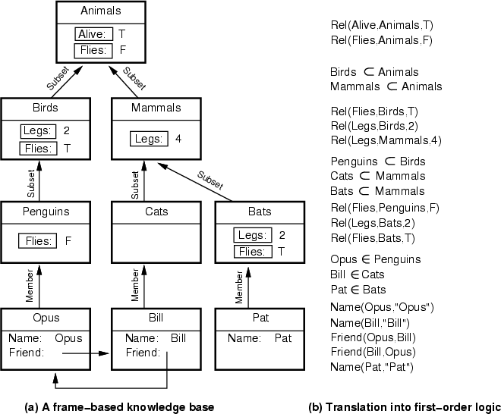

Slide 42


